Slide 1
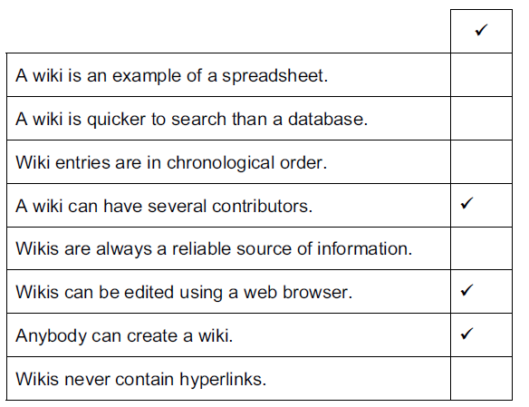
Tick three features of wikis.

Slide 2
HTTP is an internet protocol. Explain what is meant by HTTP.
HyperText Transfer Protocol
HTTP is a communication protocol used on the internet to allow communication between two
computers (devices)
HTTP is an application protocol/set of rules
HTTP is the foundation of data communication for the World Wide Web
Explain the differences between HTTP and HTTPS.
HTTP is not secure/HTTPS is secure…
…uses SSL/HTTP does not use SSL
HTTPS transmits data over the internet in an encrypted form/HTTP transmits data over the internet in an unencrypted form
HTTPS requires additional processing power in its servers which could result in slowdown of Responses

Slide 3
Give four reasons why an internet search to find relevant information is not always fast.
Computer might be infected with spyware detecting key presses which slows down data transfer speeds over the internet
Computer might be infected with viruses taking up memory and limiting bandwidth.
If the computer’s memory is close to full, data transfer speed over the internet can slow down considerably
The search might be too general giving irrelevant information as well as relevant information
Search providers add targeted marketing adverts from companies to the search results/ your search results are gathered to target further marketing/advertising

Slide 4
Describe what is meant by a microblog.
It is a form/type of blog
Shorter in length than a normal blog
Consist of short sentences
Posts are called microposts
Accessed by subscribers
Give four benefits of using social networking sites.
Easy to keep in immediate contact with friends/make new friends
Easy to communicate to more than one friend/to communicate with people overseas
Can search for people who you’ve fallen out of touch with
Easy to arrange meetings/visits to cinemas/theatre
Can share photographs/videos/images/opinions/views

Slide 5
Ajit has been set homework by her Geography teacher. She has the choice of using her text book or the internet to find the necessary information.
Discuss the advantages and disadvantages to Ajit using the text book rather than the internet.
Advantages
No danger of accessing inappropriate information
Relevant information can be found quite quickly
Don’t have to worry about having to have internet connectivity/computer/phone line/modem
Book will be less biased/more reliable as teacher has recommended it
Index makes searching more efficient
Disadvantages
Book has limited amounts of information
Can be slower to find relevant information than using a search engine
Books can go out of date quickly/difficult to update a book
Books don’t have multimedia to help explain information
Easier to detect plagiarism

Slide 6
Students at a school visit a variety of websites on the internet to get information about a topic. Describe four features of a website that will prove that the information found on it is reliable.
Can use the final part of a URL to identify reliability
.ac, .gov, .org are usually fairly reliable
If information matches that from reliable sites or reliable/authenticated text books
If responsible bodies have endorsed the site information will be reliable
If it has links to other reliable sites then information will be reliable
If site has testimonials it is likely to be reliable
If the author’s credentials are good it is likely to be reliable
Describe three other features of a website that may indicate that the information found on it is not likely to be reliable.
If site has excessive advertising it could be unreliable
If the advertising is related only to its own products it could be unreliable
If the date of the last update was a long time ago it is likely to be unreliable
If it has links to other unreliable sites it could be unreliable

Slide 7
Students at a school visit a variety of websites on the internet to get information about a topic. Describe four features of a website that will prove that the information found on it is reliable.
Can use the final part of a URL to identify reliability
.ac, .gov, .org are usually fairly reliable
If information matches that from reliable sites or reliable/authenticated text books
If responsible bodies have endorsed the site information will be reliable
If it has links to other reliable sites then information will be reliable
If site has testimonials it is likely to be reliable
If the author’s credentials are good it is likely to be reliable
Describe three other features of a website that may indicate that the information found on it is not likely to be reliable.
If site has excessive advertising it could be unreliable
If the advertising is related only to its own products it could be unreliable
If the date of the last update was a long time ago it is likely to be unreliable
If it has links to other unreliable sites it could be unreliable

Slide 8
Explain what is meant by a URL.
A URL is a Uniform Resource Locator
Is the unique address for a file that is accessible on the Internet
It consists of a protocol usually http or https
Then a domain name that identifies a specific computer on the Internet
Then a pathname that specifies the location of a file in that computer.
FTP is an internet protocol. Explain what is meant by FTP and how it differs from HTTP.
File Transfer Protocol/is used to transfer files from one computer to another
Differences
HTTP is used to access the world wide web/web sites
FTP is used to download from file servers whereas http is used to download from web servers
FTP – files are transferred from one device to another and copied into memory
HTTP transfers the contents of a web page into a browser for viewing.
FTP upload is used in cases when the file size is very large
HTTP upload is used for smaller files.

Slide 9
Information on the internet can sometimes be unreliable. Discuss ways you could minimise the chance of finding unreliable information when searching the internet.
Avoid using information from sites that have excessive advertising
Avoid using sites where the information from sites where advertising is related only to its own products…
Avoid sites where the date of the last update was a long time ago…
Avoid using wikis/sites which the user can edit
Avoid using blogs/sites which are clearly the owner’s point of view/social networking sites
Avoid using sites which have grammatical/spelling mistakes
Use information from sites where responsible bodies have endorsed the site/sites which have links to other reliable sites/sites which have testimonials
Use sites where the author’s credentials are good
Use sites which have .ac… , .gov, .edu as the final part of the URL/only use government/academic sites
Ask teachers for advice on a site

Slide 10
Explain the meaning of the following email terms:
Cc: As well as the recipient this sends a copy of the email to the email addresses listed after cc
Bcc: bcc is the same as cc except that the recipient is unaware that copies have been sent
Forward: This sends a message that has been received to another email address
Group: This is a group of email addresses that are given a group name so that the sender only needs to type in one name to send an email to several recipients at once
Attachment: A file that is sent attached to/with the email

